Slide 1
Role of Integrated Marketing
Communications
Overview

Slide 2
A Definition
Integrated Marketing Communication…..
is a process for planning, executing & monitoring the brand messages that create customer relationships
Duncan, Principles of Advertising & IMC, 2005:17

Slide 3
Integrated Marketing Communication (IMC)
IMC “is the coordination and integration of all marketing communication tools, avenues, and sources within a company into a seamless program that maximizes the impact on consumers and other end users at a minimal cost” (Clow & Baack, 2007, p. 8).
3

Slide 4
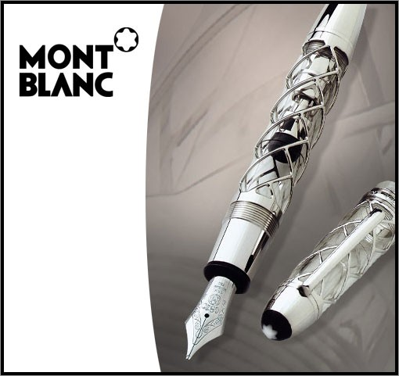
Mont Blanc use a variety of marketing mix elements, including price, product, design, brand name and distribution strategy to create high-quality, upscale usage image for its pens.
Mont Blanc

Slide 5
Impact of IMC
IMC plays a role in all:
▪▪ Business-to-business (B2B) interactions.
▪▪ Marketing channel communications.
▪▪ Customer-focused communications.
▪▪ Internally directed communications.
5

Slide 6
The Goal of IMC
As with all marketing activities, the goal of IMC is to build brands.
Brands that are well known and liked are more likely to be purchased → increase profit margins.
Brand Equity: “the intangible value of a brand
– value added to a product or service that derives from a perception in customer’s minds” (Duncan, 2005, p. 8).
6

Slide 7
Benefits of IMC
IMC provides greater:
▪▪ Brand differentiation.
▪▪ Accountability within a firm.
▪▪ Trust among consumers.
▪▪ Levels of effectiveness in cutting through message clutter than single strategies.
7

Slide 8








The Changing World of MC
Old World New World
“Talking At” Consumers
Two-way Dialogue With Consumers
Focus on Winning New Customers
Focus on Building Long Term Relationships With Consumers
Marketers Relied Primarily on Advertising and Promotions
Marketers Use and Coordinate Many Different Forms of Communication With Consumers
8

Slide 9
IMC – The Evolution
Mass Marketing Using mass communication
to Relationship Marketing
Using integrated marketing communication with a
focus on interaction

Slide 10
What trends are driving integration?
External
Brand & product proliferation
Customisation
Decreasing brand loyalty
Price sensitivity
More demand, less trust
Clutter
Service Economics
Rising Costs & Accountability
Internal
Expertise
Corporate missions
Communication technology
Benefits to be gained

Slide 11
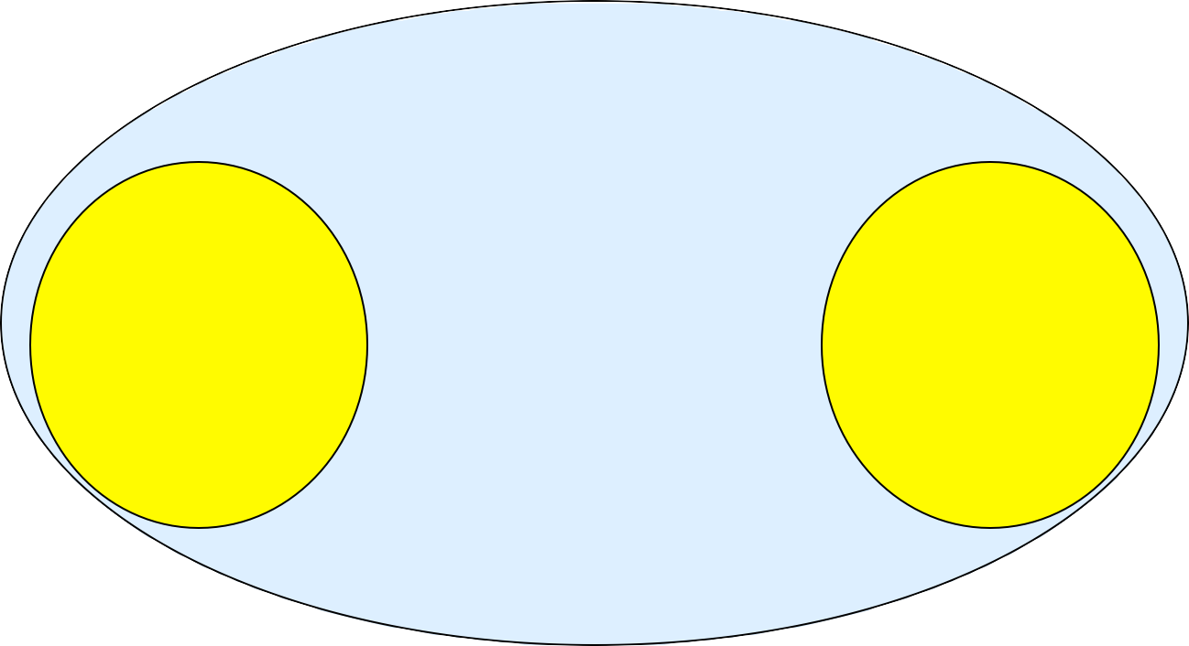
Interaction Model
Environment
Market structure Dynamism
Internationalisation Channel position Social system
Atmosphere
Power/dependence Co-­‐operation
Closeness Expectations
Organization
Technology Structure Strategy
Organization
Technology Structure Strategy
Long term relationships
Institutionalisation, Adaptations
Individual
Aims Experience Skills
Interaction Process
Short term exchange episodes
Products/services Information Financial
Social
Individual
Aims Experience Skills
Source: Adapted with permission from Håkansson (1982, p24)

Slide 12
Industrial Network
IOR
Marketing Channel
Supply/Demand Chain
Upstream suppliers
Direct suppliers
Supply network
Manu-­‐ facturers
Distributors
Distribution network
Customers

Slide 13
IMC & the need for integration
Covers a number different media and strategies
TV, radio, Direct, PR, social media etc
Selective combination of appropriate types of communication
Meeting a common set of objectives for the brand
Integration over time with regard to customers
Integration provides synergy

Slide 14






Integration and Synergy
Integration
=
Synergy
When brand messages are integrated…
…they reinforce each other…
… and create a synergy effect like:
14

Slide 15
The Marketing Communication Matrix
Ballantyne, Luxton, Powell (2004) Introduction to Marketing: A value exchange approach ed Gabbott, Pearson:381
Mass Market
Segmented/Mass Individual Customisation
2-way communication An interactive approach (listening & learning including informal dialogue initiated by planned messages)
1-way communication Conventional mass marketing

Slide 16
The Importance of Integration
▪▪ Integration begins with the way a company and its agencies organise the process for creating and delivering brand messages.
▪▪ All participants involved in creating and delivering brand messages must work together:
▪▪ The company,
▪▪ Company agencies,
▪▪ The media,
▪▪ Channel members, and
▪▪ MC support services.
16

Slide 17
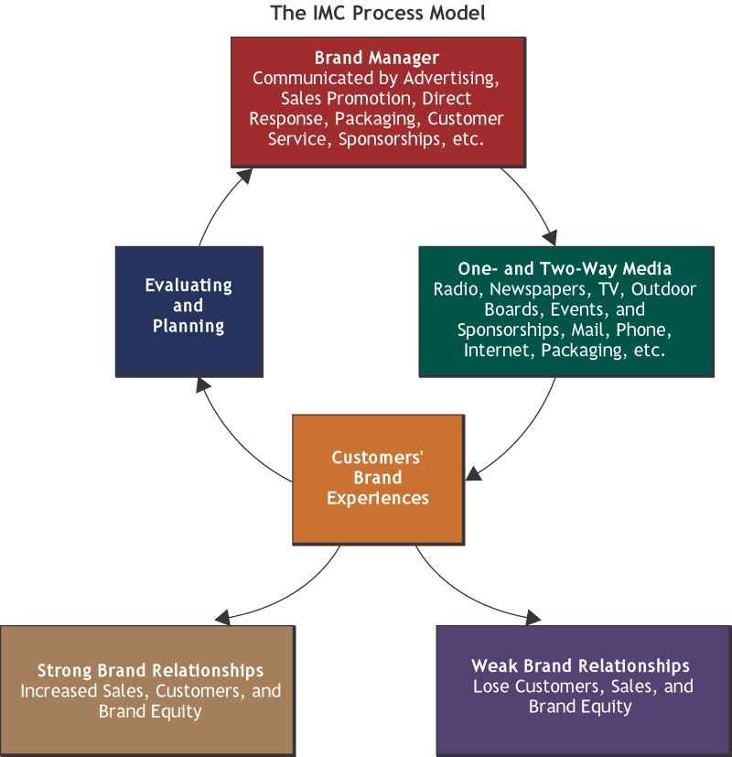
17

Slide 18
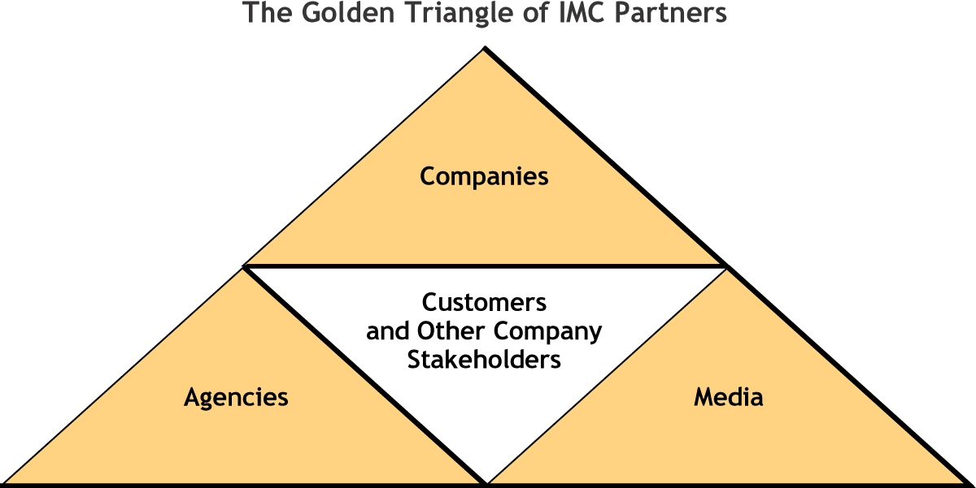
The Key Players in the IMC Process
18

Slide 19


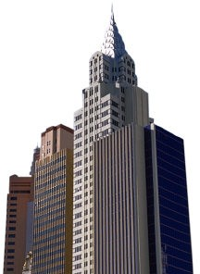





Organisations: Nike as an example
B2B
Nike’s Relationship with shoe retailers like Foot Locker
B2C
Niketown stores selling shoes directly to consumers
19

Slide 20
The 8 Key Functions of Marketing Communication
▪▪ Advertising
▪▪ Direct marketing
▪▪ Publicity (public relations)
▪▪ Sales promotion
▪▪ Personal selling
▪▪ Internet/ Social media
▪▪ Events and sponsorships
▪▪ Packaging
20

Slide 21
What is Advertising?
Consumer & B2B different
Refers to space/time for which a price is paid by the advertiser to the media owner
Refers to messages over which the medium exercises no editorial control (other than accept/ reject)
Media=TV, radio, cinema, newspapers & mags, outdoor, digital & ambient
Is conventional advertising under threat?

Slide 22
What is Direct Marketing?
Selected & selective distribution & communication channel
Direct Response & interactive
Media involved
Print
TV (digital)
Telemarketing
Internet (includes viral, blogging)
Is junk mail Direct Marketing?
Where does podcasting fit in?
Are online social networks the most direct?

Slide 23
Publicity & Public Relations
“Publicity is stories and brand mentions delivered by the mass media without charge” (Duncan, 2005, p.
10).
Public Relations “are communication activities that help an organization and its publics adapt mutually to each other” in an effort to gain the support and cooperation of those publics” (Duncan, 2005, p. 10).
Source: http://commercial-archive.com/132015.php ₂₃

Slide 24
What is Brand Public Relations?
All the company’s efforts to foster better relations with its various publics or stakeholders, beyond relationships necessitated by sales transactions
Is it the same as publicity?

Slide 25
What is Sales Promotion?
Can take many forms (samples, bonus packs, sweepstakes, coupons, competitions etc etc)
Targeted at trade & customers
Short term focus
Are “Price Offs” sales promotion?

Slide 26
Personal Selling?
Social selling
Customer retention
Customer acquisition
Referrals and Cross selling

Slide 27
Internet / Social Media
True One on Marketing
Co-creating with customer
I.e. Face book, twitter, Utube, Linkedin, Slideshare etc

Slide 28
Events & Sponsorships
Events: A highly targeted brand-associated activity designed to actively engage customers and prospects and generate publicity
Example: Harley Owners Group motorcycle rallies.
Sponsorships: Financial support for an organisation, person, or activity in exchange for brand publicity and association
Example: Nike’s sponsorship of Tiger Woods.
28

Slide 29
Packaging
Communicates value and quality
Protects product
Ways of differentiating product
Visually impactful

Slide 30
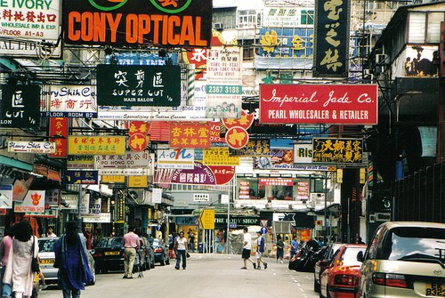
Message Clutter and IMC

Slide 31
Developing the Integrated Marketing Communication Program
Being critically aware of the planning process as a process
Evaluating the outcomes
Monitoring and Control
Eg. continuous tracking

Slide 32
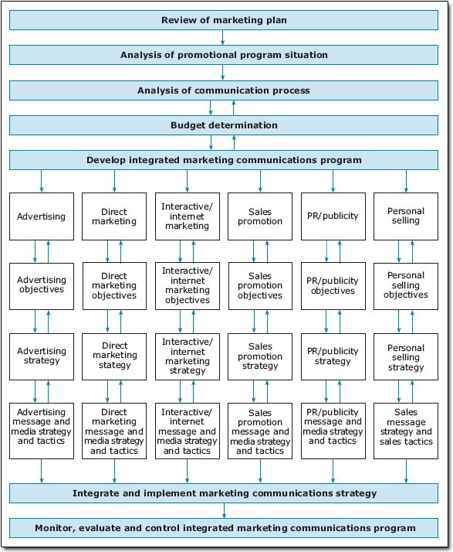
Integrated Marketing Communications Model

Slide 33
Key Success Factors in IMC
Smith (1996) put forward a summary of the guidelines for effective integration:
Ensure senior management understanding & support for IMC implementation
Ensure IMC is implemented horizontally
Ensure common visual standards are maintained
Have clear communications objectives, clear positioning statements, & link core brand values into every communication
Start with a zero budget and build communications plan around objectives
Design communications around the customer's buying process
Ensure all communications help to develop stronger relationships and brand values with customers
Develop a good marketing information system
Share artwork & other media
Be prepared to change it all

Slide 34
Summary
A Definition
Trends influencing IMC
Elements of IMC & Definitions
The Marketing Communication Planning Process

Slide 35
Conclusion
Don’t think too narrowly
Communication is not merely advertising
Think outside the box
What does the brave new world of the 21st century hold for us?

Slide 36

You are welcome to contact Nigel Bairstow at B2B Whiteboard your source of B2B Asia / Pacific marketing advice
http://www.linkedin.com/pub/nigel-bairstow/6/41b/726 http://twitter.com/#!/b2bwhiteboard

